Slide 1
Potential Reserve Methodology
Prepared for the Annuity Reserve Work Group
By Steve Strommen FSA, CERA, MAAA
May 1, 2013

Slide 2
A Principles-based approach
Starts with small set of scenarios for each assumption
Includes “best estimate”, some good, some equally bad
Probability weight assigned to each scenario
Uses “Scenario Reserves”
Present value of cash flows using scenario-specific assumptions
Discounted using the portfolio earned rate in the scenario
Final “best estimate” reserve is probability-weighted average of scenario reserves
Capital and aggregate reserve margin are based on differences of scenario reserves from “best estimate”

Slide 3
Constructing the scenarios
Assume we know the distribution of each assumption
Scenarios are defined by a path of shocks or percentile points, one per year
Set the shocks or percentile points to achieve a desired probability level for the scenario
Use the theory of random walks
Std. deviation for N periods is $\sqrt{N}$ times std. deviation for one period
Probability level for a scenario of N periods is estimated by the sum of the shocks in light of the std. deviation for N periods.

Slide 4
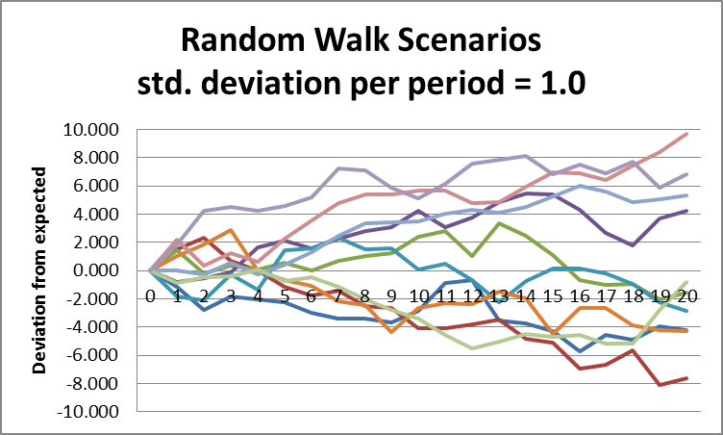
Using statistics of random walks
Each time period is one step forward
Sideways (up or down) step each period averages zero, but has std. deviation = 1

Slide 5
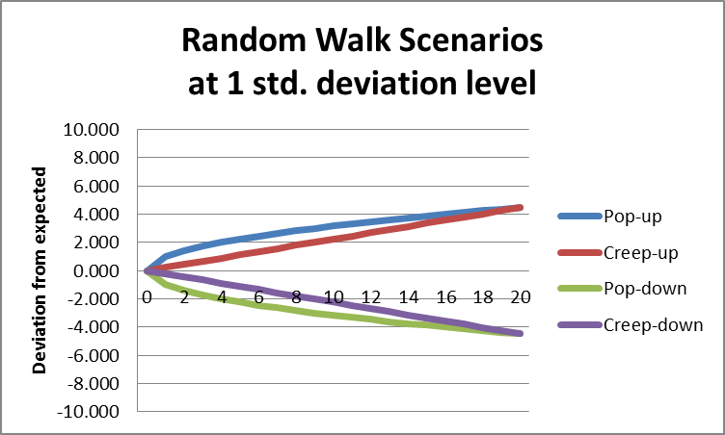
Using statistics of random walks

Slide 6
Constructing the scenarios
Pop-up scenario at 84th percentile (1 std. deviation)
Sum of shocks is always at 1 std. deviation level for N period random walk
So sum over N periods is $\sqrt{N}$ times single period std. deviation
Shock for Nth period is always $\sqrt{N}−\sqrt{N−1}$ times single period std. dev.
Creep-up scenario at 84th percentile (1 std. deviation)
Sum of shocks over creep-up period is $\sqrt{N}$ times single period std. deviation
Equal shocks each period, so each shock is $\sqrt{N}/N$ times single period std. dev.

Slide 7
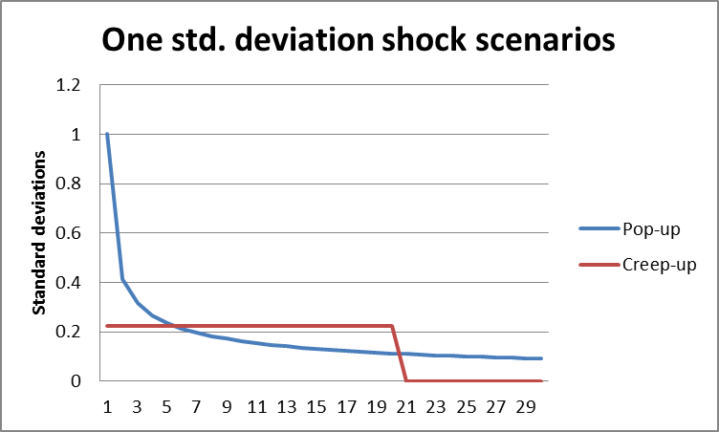
Constructing the scenarios shocks measured in standard deviations

Slide 8
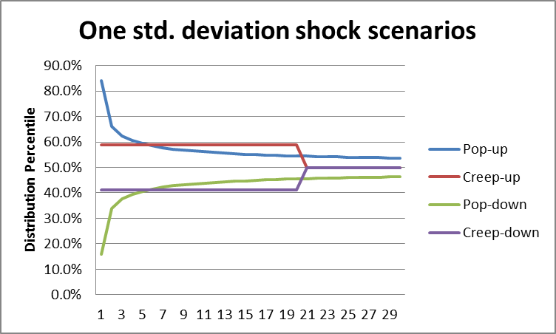
Constructing the scenarios Shocks measured at percentile level

Slide 9
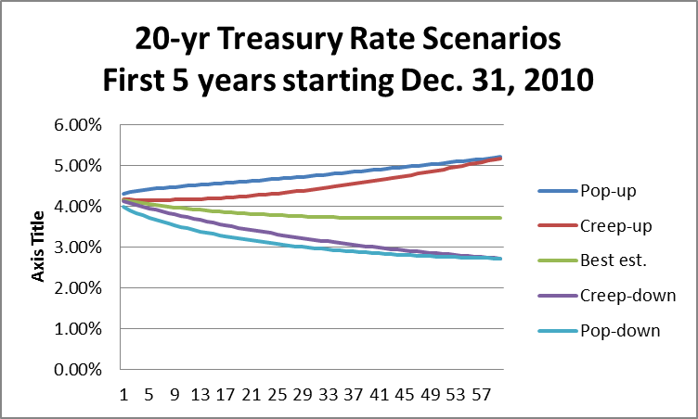
Constructing the scenarios interest rates – use scenario shocks in the generator

Slide 10
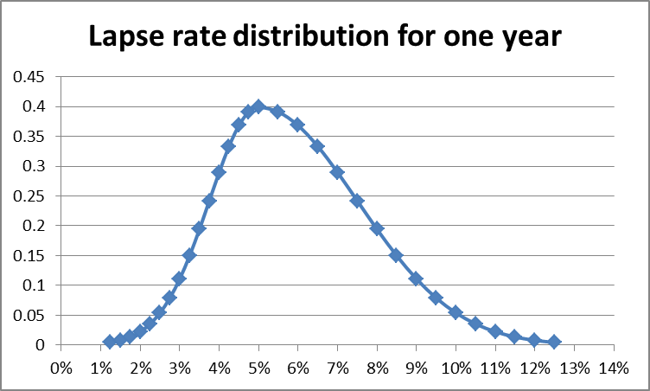
Constructing the scenarios Other assumptions
Assume we know the distribution function for each year for each assumption
Simple illustration for a lapse rate with 5% “best estimate”:
Notes:
Note the skewed shape of the distribution.

Slide 11
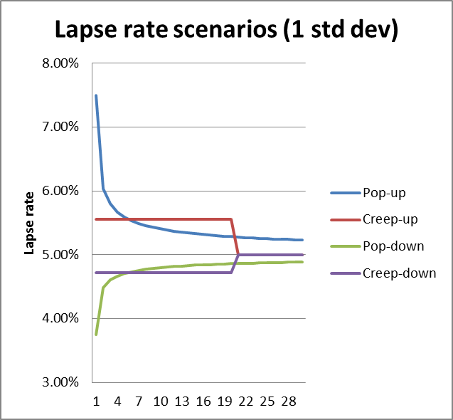
Constructing the scenarios
For simplicity, if we assume the same distribution for each projection year, we get the following scenarios:
Sets of scenarios like this can be generated at any number of std. deviations. (any probability level). One set could be at the level for reserves, one at the level for capital.
Notes:
Note that the spacing of the scenarios reflects the skewed shape of the distribution.

Slide 12
Constructing the scenarios mortality
At least two separate aspects
Random variation around the best estimate
Can be handled much like lapse rates illustrated earlier
Trend
Need a “best estimate” trend, e.g. a projection scale
Need a distribution for the annual mortality improvement factor in order to apply the methodology illustrated earlier.
Scenarios would involve faster or slower improvement, based on percentage points in the distribution of annual mortality improvement rates.

Slide 13
Creating the scenarios Election rates
Election rates are sensitive to “money-ness”
Degree of sensitivity is uncertain
One could develop a probability distribution for a “sensitivity factor”
Scenarios would vary by level of sensitivity factor
Example:
Define M = “moneyness” = (value of option) / (best est. reserve for contract)
Define sensitivity factor S
Scenario election rates = (best est.) + S(M-1)²
Value of S is calibrated to desired percentile point on its distribution

Slide 14
Calculating the reserve sample product - spda with Glib
Current cash value = $100,000
Guaranteed minimum crediting rate = 2.5%
GLIB roll-up rate = 5.0%
Attained age 50
Best estimate scenario reserve = $95,000
These parameters are purely to set the stage for thinking about the calculation.
All calculation results to be shown are purely illustrative and have not been developed from an actual model (yet).

Slide 15
Calculating the reserve
Choose a set of critical (sensitive) reserve assumptions, e.g.
Investment returns
Mortality
Lapse
GLIB option election rates
For each assumption, generate 5 (or more) scenarios, e.g.
3 std. deviations worse than expected
1 std. deviation worse than expected
As expected
1 std. deviation better than expected
3 std. deviations better than expected

Slide 16
Calculating the reserve
Calculate “scenario reserve” for each scenario for each assumption
“Best estimate” is probability-weighted average “scenario reserve”
This is an average over all assumptions, not each assumption separately
Capital required for each assumption is excess of greatest scenario reserve for that assumption over the “best estimate”.
Aggregate capital requirement is sum of amounts for each assumption, adjusted for correlation
Aggregate margin can be based on the capital requirement
Details to be covered later

Slide 17
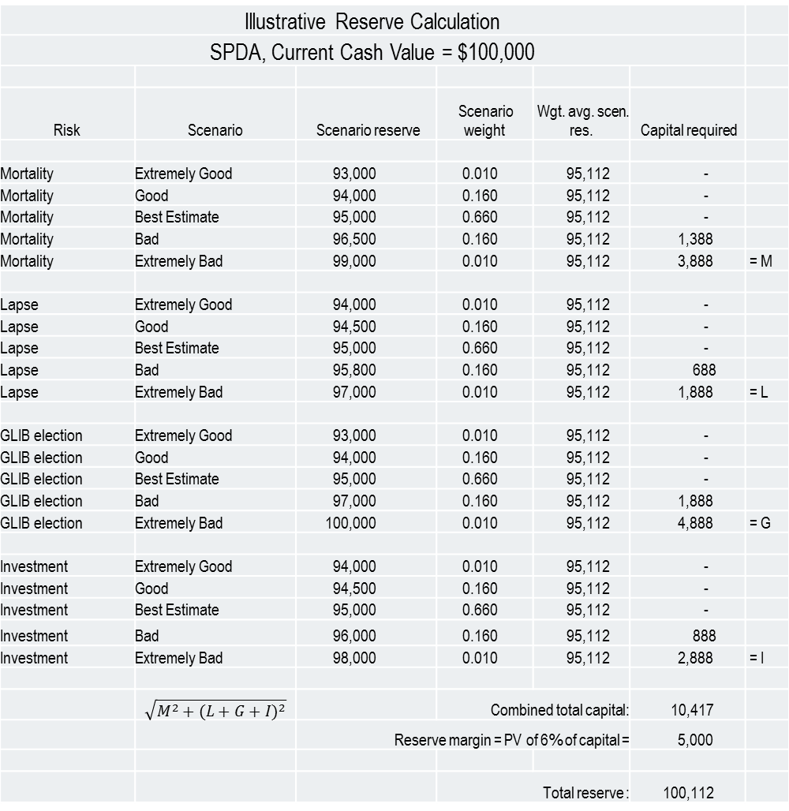
Illustrative Reserve Calculation
SPDA, Current Cash Value = $100,000
Risk | Scenario | Scenario reserve | Scenario weight | Wgt. avg. scen. res. | Capital required
Mortality | Extremely Good | 93,000 | 0.010 | 95,112 | -
Mortality | Good | 94,000 | 0.160 | 95,112 | -
Mortality | Best Estimate | 95,000 | 0.660 | 95,112 | -
Mortality | Bad | 96,500 | 0.160 | 95,112 | 1,388
Mortality | Extremely Bad | 99,000 | 0.010 | 95,112 | 3,888 | = M
Lapse | Extremely Good | 94,000 | 0.010 | 95,112 | -
Lapse | Good | 94,500 | 0.160 | 95,112 | -
Lapse | Best Estimate | 95,000 | 0.660 | 95,112 | -
Lapse | Bad | 95,800 | 0.160 | 95,112 | 688
Lapse | Extremely Bad | 97,000 | 0.010 | 95,112 | 1,888 | = L
GLIB election | Extremely Good | 93,000 | 0.010 | 95,112 | -
GLIB election | Good | 94,000 | 0.160 | 95,112 | -
GLIB election | Best Estimate | 95,000 | 0.660 | 95,112 | -
GLIB election | Bad | 97,000 | 0.160 | 95,112 | 1,888
GLIB election | Extremely Bad | 100,000 | 0.010 | 95,112 | 4,888 | = G
Investment | Extremely Good | 94,000 | 0.010 | 95,112 | -
Investment | Good | 94,500 | 0.160 | 95,112 | -
Investment | Best Estimate | 95,000 | 0.660 | 95,112 | -
Investment | Bad | 96,000 | 0.160 | 95,112 | 888
Investment | Extremely Bad | 98,000 | 0.010 | 95,112 | 2,888 | = I
 | $$\sqrt{M^{2}+{(L+G+I)}^{2}}$$ |  | Combined total capital: |  | 10,417
 |  | Reserve margin = PV of 6% of capital = |  |  | 5,000
 |  |  | Total reserve : |  | 100,112
$$\sqrt{M^{2}+{(L+G+I)}^{2}}$$
Notes:
Figures shown on this slide are purely illustrative and have not been produced by a model of any kind.
The scenario weights add to 1 within each assumption, and need to be divided by the number of assumptions to get the weights for the weighted average scenario reserve.

Slide 18
Calculating the aggregate margin Confidence level method
TAR is “best estimate” reserve + 3 std. deviations
Aggregate reserve margin is 1 std. deviation, capital is 2 std. deviations
Conceptual problem (my opinion)
If reserve margin is not released when adverse event occurs, then capital of 2 std. deviations is not sufficient for 3 std. deviation event. Company is left with assets less than reserves and needs not only a capital infusion (obtainable from capital markets) but a reserve infusion from guarantee funds.

Slide 19
Calculating the aggregate margin Cost of capital method
TAR is “best est.” reserve plus aggregate reserve margin plus capital
Capital is 3 std. deviations (not 2)
May be measured over shorter period, leading to comparable level
Resolves conceptual problem of confidence level method (my opinion)
Aggregate reserve margin is PV of “cost of capital”
Cost of capital is e.g. 6% of annual projected capital requirement
Capital requirement projection is required
Projected capital can be estimated as % of projected best est. reserve or by 2 or 3 factor formula calibrated to initial capital
Not uncommon for aggregate margin to be approximately half of capital for a long term contract (PV annuity factor ~ 8, and 6% x 8 = 48%)
This is comparable to ratio of reserve margin / capital for the confidence level method
Notes:
The concept of policyholder protection embodied in the cost of capital method is that when a company suffers a loss that depletes its capital, it can raise capital from capital markets to get back on its feet. The margin in the reserves provides for the cost of raising capital from outside sources. Because of this, the company could also recover by selling the business, providing assets equal to reserves to the buyer.
So when a 3-std deviation loss occurs, the company is left with assets equal to reserves that provide for the cost of raising capital. The company does not need guarantee funds to recover.
The distribution of losses is measured differently for the confidence level method vs. the cost of capital method. The projection period differs.
The projection period for the confidence level method is the life of the contract.
The projection period for the cost of capital method is the time required to take regulatory action in response to a major loss, and can be as short as 1 year (I recommend several years). This leads to a smaller standard deviation of losses. That is why capital of 3 standard deviations under the cost of capital method is not necessarily greater than capital of 2 standard deviations under the confidence level method – the standard deviation being measured is conceptually different.

Slide 20
Testing the reserve
Reserve adequacy testing (a.k.a. cash flow testing) would still be performed
This could be transformed into a series of specified stress tests that combine adverse experience on more than one risk.
As with cash flow testing today, the actuary would apply judgment when determining whether to increase reserves based on stress test results.

